Slide 1
Role of Knowledge Management in Agile Execution during Pandemic
Author 1: Vishwa Bhushan Author 2: Prof. V S Prakash Attili

Slide 2

Content
01
Introduction
Agile, Knowledge Management, Pandemic Puts Agile to test, Broad Research Questions.
02
Literature Review
Agile, Knowledge Management
03
Research Methodology
Discussion and Proposed Model
04
Conclusion and Future Scope
05

Slide 3
Introduction

Slide 4
Agile
Buzzed Methodology
Why?
Advantage
Knowledge
Legacy businesses have also embraced Agile.
Businesses with a workforce of more than 20,000 have used Agile for at least five years.
not only using the methodology for IT but also newer areas such as Operations.
Focus on people and the synergy between them.
Intra and inter-team collaboration, customers’ involvement,
Meeting the ever-evolving requirements.
Helps in the effective and efficient sharing of knowledge within the team space
Software development project goes through a lot of knowledge and information flow.
Agile backers often cite this gospel to stress the need for managed knowledge, a key process in the methodology.
The other methodologies had one common limitation of accommodating and responsiveness to changes during a project life cycle.

Slide 5
Knowledge Management
Knowledge for an IT Project
knowledge refers to the information flow, which usually consists of documentation of the projects, manuals, reports, etc.
Knowledge and Agile
Promotes informal communication, removing unnecessary writing and time consuming “Writing-everything down”. It provides extra flexibility for intra and inter team collaboration
Current Knowledge Management in an organization
Many companies have started to restructure knowledge management through a GitHub-like knowledge repository. It allows the free flow of data and easy document maintenance

Slide 6
Pandemic puts Agile to test
The COVID-19 pandemic forced a drastic change in how firms and employees function.
Remote working and collaboration becoming a mainstay.
Agile faced its biggest challenge – how to efficiently collaborate remotely?
According to a McKinsey report, Agile-equipped firms were better prepared to deliver projects despite their workforce mostly worked from home.

Slide 7
Broad Research Questions
What is the role of knowledge management in Agile execution?
What kind of knowledge management techniques/approaches helps in ensuring timely delivery of projects?
Amid layoffs/attrition, how did agile firms ensure timely delivery of projects?

Slide 8
Literature Review

Slide 9
Agile
4 Values
Individuals and interactions over processes and tools.
Working software over comprehensive documentation.
Customer collaboration over contract negotiation.
Responding to change over following a plan
Agile was formalized in 2001 when a group of 17 IT pundits banded together to introduce an Agile Manifesto.
12 Principles
The objective of the manifesto was to identify and develop an alternative to documentation-driven and heavyweight software development processes.
1. Our highest priority is to satisfy the customer through early and continuous delivery of valuable software.
2. Welcome changing requirements, even late in development. Agile processes harness change for the customer's competitive advantage.
3. Deliver working software frequently, from a couple of weeks to a couple of months, with a preference to the shorter timescale.
4. Business people and developers must work together daily throughout the project.
Agile Manifesto Talks about 4 Values and 12 principles around which all IT projects revolves .

Slide 10
12 Principles Cont.
5. Build projects around motivated individuals. Give them the environment and support they need, and trust them to get the job done.
6. The most efficient and effective method of conveying information to and within a development team is face-to-face conversation.
7. Working software is the primary measure of progress.
8. Agile processes promote sustainable development. The sponsors, developers, and users should be able to maintain a constant pace indefinitely.
9. Continuous attention to technical excellence and good design enhances agility.
10. Simplicity--the art of maximizing the amount of work not done--is essential.
11. The best architectures, requirements, and designs emerge from self-organizing teams.
12. At regular intervals, the team reflects on how to become more effective, then tunes and adjusts its behavior accordingly.
Values in Nutshell
The 4 values talks about collaboration, interaction, creating innovative environment, early deliverables, accommodating changes, and frequent customer interaction.
Principles in Nutshell
The principles talks about customer satisfaction, building environment for building collaboration. Promoting face to face interaction, regular intervals for team retrospectives.
Agile Methodology
Scrum and Kanban are some most used agile methodologies.

Slide 11

Knowledge Management
Knowledge has been defined as an “understanding, awareness, or familiarity acquired through study, investigation, observation or experience over time.
In the context of modern organizations, knowledge management is essentially the repository of all the information that is there.
Explicit knowledge is formal as it is structured and systematic language. It could be in any form -- a manual, document, statements, and more. Thus, it makes explicit knowledge easily transferable
Tacit knowledge is intangible, such as thought process. Hence, it is important to document these thoughts so that they can eventually become explicit knowledge..
Explicit
Tacit
Agile
Overcoming the Limitations
Agile is more about informal communication and less documentation, it focuses on making entire knowledge sharing using tacit means.
Firms are promoting pair programming, writing solution articles, sharing retrospective meeting notes, and detailed documented discussions. Teams are being encouraged to contribute to convert their tacit knowledge to explicit or learn from what already has been shared.

Slide 12
Research Methodology

Slide 13
Research Methodology
Multi Case Study Approach
Conducted Qualitative Research with Industry executives
Based on Broad Research Question, tried to take insight on
Agile in Pandemic
Knowledge Management
Employee Attrition
Unit of Analysis – Project that executes an Agile Way
Designation (Job Profiles) | Number of Participants
Scrum Developers (Dev/Test/Analysts) | 4
Sr. Scrum Developers (Technical Managers) | 2
Scrum Masters (Ex. Project Managers) | 4

Slide 14
Discussion and Proposed Model

Slide 15
Discussion
Communication
To understand how the change environment has affected communication
01
02
Knowledge Management and Knowledge Repository
Understanding Knowledge Management and Knowledge Repository to overcome communication challenge, and using it when employee leaves
03
Employee Attrition
What does a firm do in when an employee leaves the project at various stages.

Slide 16
Comments and Feedbacks from Research
Communication
Knowledge Management and Knowledge Repository
Employee Attrition
the requirement of Agile is that team needs to work in an in a particular space together, but that's not a scenario in pandemic right. So, there is a huge challenge in terms of availability of a particular resource.
the communication part has improved. Nowadays, people are aware to use the technology.
if I talk about, if my team takes up, 10 to 15 minutes for a stand-up. Now it has turned to 40 minutes or 45 minutes because they do not know the availability of people again, they have to project for a particular task
it has helped the projects to keep the deliveries going on time, and with the deadlines that were planned. This is just because it has cycles it has different sprints going on, and the plans are very flexible.
Yes. Oh, it has been a great benefit. So, the repository we use is a wiki, so we make Wiki pages for everything.
create a document whatever they develop, they use to create a document, and that helps me as a lead.
our business was on the negative side. So, we were losing all the businesses. I think adapting to the COVID times due to the knowledge that we have in our company helped us a lot like we initiated few key things in our hospitality business.
I conducted I think one training for the major project deployment where I worked. And in that training, everybody including the manager and the teammates were there and were asking questions in the training.
expect that proper documentation should be there or a proper training should be there like who can guide us, or explain the entire process like whatever has been done, not in terms of the line by line code but in terms of like, theoretically.
we have learned to have a little redundancy available. So that work does not get hamper when somebody critical leaving over here impacts the project, because whatever redundancy you create an individual experience has something that cannot replace, even if it is replaced with the higher qualified person, experience is something you cannot replace in some sense.
the ones that are supposed to, he or she is on the notice period, then a knowledge transfer session is held, and with a given timeframe we do. If there is a new resource coming then we give it to the new resource or otherwise the manager or the lead, or the other members of the team, take all the necessary KT

Slide 17
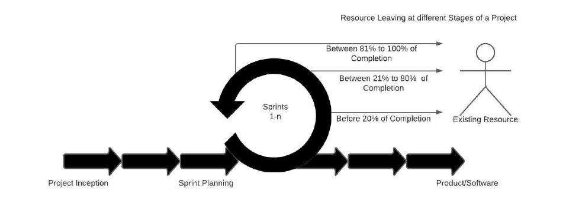
Proposed Model
Resources Leaving the Project at Different Stages.

Slide 18
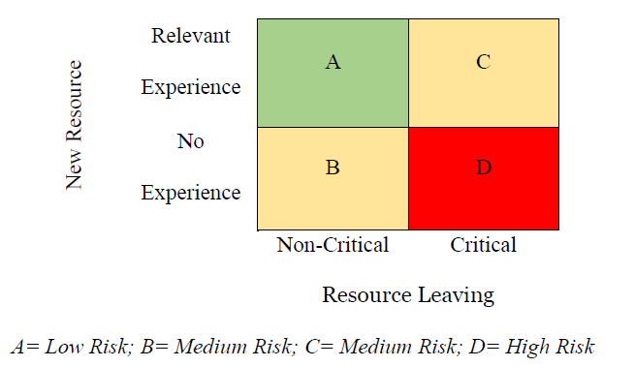
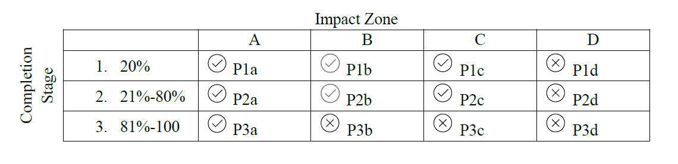
Risk Zones – Criticality of leaving resource and skill of the new resource.
Impact Zones and stages of employee attrition.

Slide 19
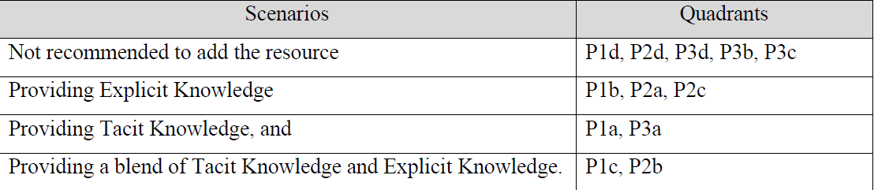
Summarizing into 4 scenarios

Slide 20
Conclusion And Future Scope

Slide 21
Conclusion
Communication, a critical factor in the agile setup did create a problem and also in the progress of the project but on the other hand, it was well managed by the breaking down of the projects into sprints and helped the employee to plan out their weeks
managers, firms have a special focus on documentation as it reduces employee dependencies.
If a firm or manager is more inclined towards the Explicit Model, they can have a long-term benefit. It can also help them to overcome any uncertain scenarios even the pandemic
most of the firms formally or informally have some knowledge repository. This knowledge repository has helped the firm and especially the employees in the COVID-19 pandemic
Firms in Agile setup if they maintain a Knowledge repository were in a much comfortable position as compared to the firms that were still in the early phase of implementing the Knowledge repository.
Agile-Scrum methodology the project broken into smaller task and sprints, and well-defined sprint planning, daily standup meetings, sprint retrospectives, it helped the Agile project progress well even when the resource had to leave or due to pandemic, the agile project run as based on planning.

Slide 22


Future Scope
The study is limited to projects that execute in a specific geographic location (Indian subcontinent) and focused on IT industry..
It would be interesting to do more in-depth research in understanding the inducting a dedicated Knowledge Manager (who can be shared with few Scrum Teams) along with Scrum Master.
Quantitative study through survey can strengthen the findings from the current qualitative multi-case study
COVID-19 has proven the importance of Agile in an IT firm but it also highlights the problem when employees sit at different work locations and the communication issues they see. It would be interesting to do more research on aligning Agile to Knowledge management..

Slide 23
Thank You

